Slide 1
Salary and compensation analysis through excel data modelling
Name :k.vinothini
Register number: 312220866
Department: bcom( general)
College: ponnusamy nadar college of arts and science

Slide 2


Slide 3
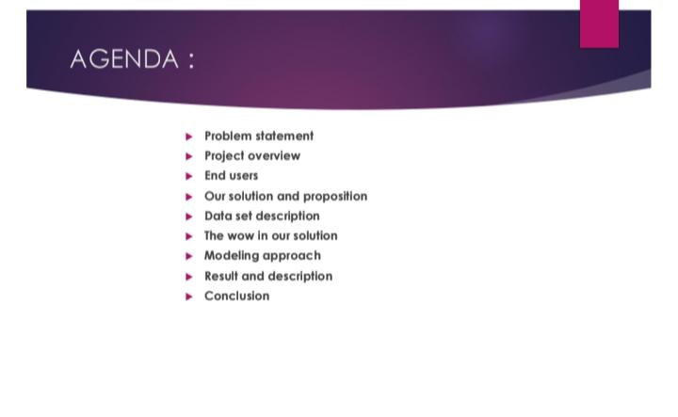

Slide 4
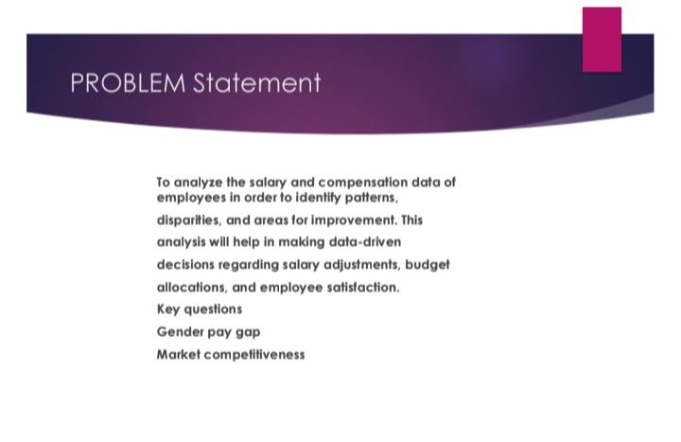

Slide 5
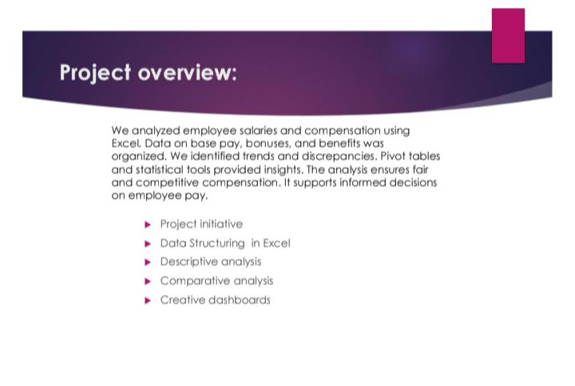

Slide 6


Slide 7
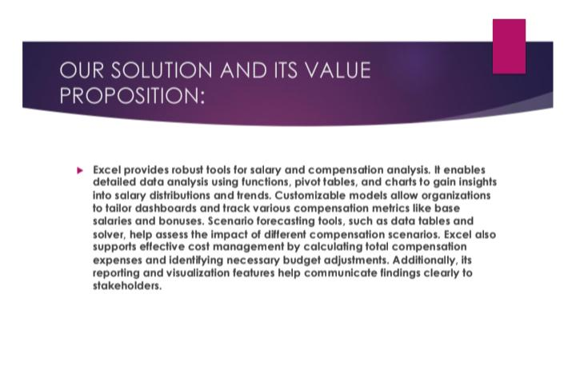

Slide 8
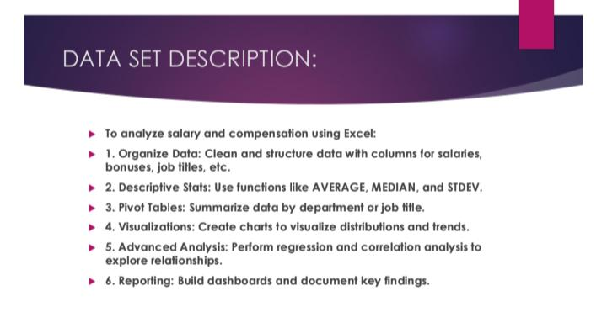

Slide 9
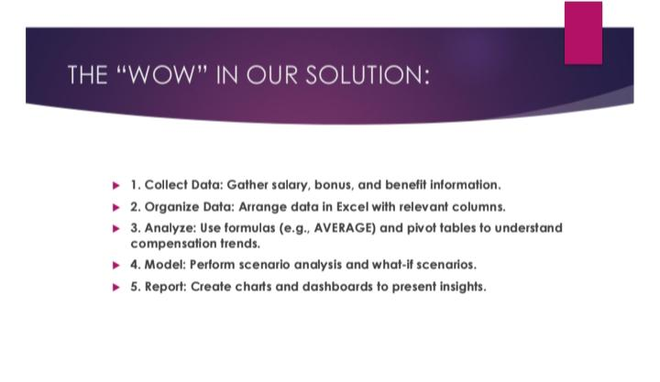

Slide 10
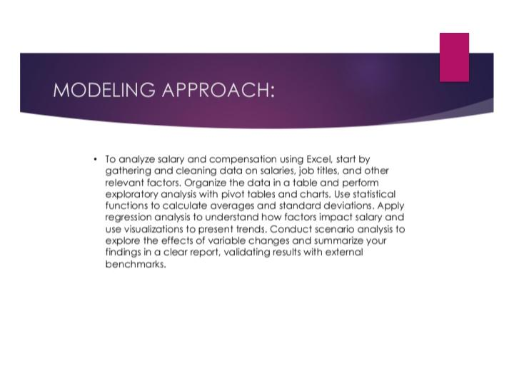

Slide 11
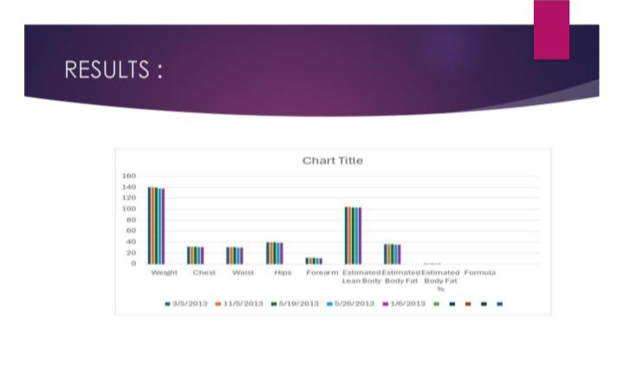

Slide 12
